Slide 1









Experiences With a FHIR Ecosystem Platform's Queryable APIs Session #78, August 10, 2021, 4:00pm, Room Summit 211, Caesars
Helen L. Hill, FHIMSS
Board Director of Public Policy, Michigan HIMSS Chapter and Board Director at Large, MIHIN
Allen Flynn, PharmD, PhD
HIMSS Michigan Chapter
Assistant Professor of Health Informatics, University of Michigan
University
of Michigan
DISCLAIMER: The views and opinions expressed in this presentation are solely those of the author/presenter and do not necessarily represent any policy or position of HIMSS.
1

Slide 2



Today’s Speakers
Helen Hill
Allen Flynn
Team Members
Michigan HIMSS Chapter and MIHIN
University of Michigan
Rutendo Goto, Intern, Interoperability Institute
Mary Kratz, Executive Vice President, Interoperability Institute
Morgan Schrauben, Human Resources Program Manager, MIHIN
Oliver Strong, Product Engineer, Interoperability Institute
Stephanie Arntson, Strategic Partnerships Manager, Interoperability Institute

Slide 3
Conflicts of Interest
Helen L. Hill, FHIMSS, is Board Director at Large for Michigan Health Information Network Shared Services (MIHIN).
The Interoperability Institute, a subsidiary of MIHIN, offers its own FHIR ecosystem sandbox (Interoperability Land™) and collaborates with the Interop.Community to offer a public, open source FHIR sandbox.
The speakers have no other real or apparent conflicts of interest to report.

Slide 4
Agenda for Today
Introduction to our Project and Partnership Program
Collaborative Partnership
Main Purpose of the Partnership
Things That Motivate Us
Technical Work on Complex, Multi-target FHIR queries (Query Kits for FHIR)
Platforms Used
Examples of Query Kits for FHIR
Educational Programming
Summary and Next Steps

Slide 5
Specific Learning Objectives
Explain what complex, multi-target FHIR® queries (Query Kits) are and do.
Critique the potential for Query Kits to fill information gaps pertaining to telehealth, medication reconciliation, and social determinants of health
Identify whether using Query Kits might provide a suitable solution for one or more health information needs of interest to YOU!

Slide 6
We Have Formed a Unique Partnership
HIMSS Michigan Chapter
Interoperability Institute
University of Michigan

Slide 7
HIMSS Michigan Chapter
Breadth and Diversity
1,700 members
Extraordinary member talent and diversity
Collaboration, Education and Leadership
Health IT & Health Info Exchange innovation, policy, workforce development
HIMSS Changemaker Chapter for advocacy
Partner on interoperability, care coordination, use of standards
Work on Michigan HIT Commission’ s Statewide 5-Year HIT Roadmap
Sponsor interns
Conduct career fairs

Slide 8
Interoperability Institute
IOI offers a neutral HIT space where …
Organizations can collectively demonstrate interoperable HIT solutions
IOI Provides the Interoperability Land™ sandbox with synthetic FHIR data
People can learn to innovate with modern technologies & standards
IOI Organizes Connectathons and Interoperathons
HIT workforce development can take place
IOI Runs an Internship Program for 100+ student interns
Recognized by HIMSS Technology Informatics Guiding Education Reform (TIGER)

Slide 9
University of Michigan’s Health IT Programs
Masters in Health Informatics
@ School of Information
Residential
≈ 40 students per year, some of whom are IOI Interns too!
Masters in Health Infrastructures and Learning Systems
@ Medical School
Online and Residential
≈ 20 students per year
PhD in Health Infrastructures and Learning Systems
@ Medical School
Residential
Notes:
Michigan offers two Masters and a PhD program

Slide 10

Collaboration
We Value Tech “Sandboxes” for…
Learning
Photo by Marvin Meyer on Unsplash
Team up to solve complex problems.
Fail and learn quickly without dire consequences.
Innovation
Validation
Gain new skills, methods & solutions.
Test rigorously with shared tools, data & personas.
Notes:
(Link back to Interop.Community and Need for Sandboxes).
Open Source Interop.Community.
For this project, we utilized Interoperability Land™.

Slide 11
Our Goal is Holistic Interoperability
high
Organizational Interoperability
TODAY WE TRY TO INSERT SOMETHING NEW
Standardized Process
Semantic Interoperability
Standardized Meaning of Terms
Standardized Queries
e.g., Query Kits for FHIR
Syntactic Interoperability
Standardized Data Exchange Formats
Technical Interoperability
low
Standardized Protocols
Based on
Oemig F, Snelick R, Healthcare Interoperability Standards Compliance Handbook. Springer International Publishing Switzerland. 2016. Page 13, Figure 1.3.
Based on Oemig F, Snelick R, Healthcare Interoperability Standards Compliance Handbook.
Springer International Publishing Switzerland. 2016. Page 13, Figure 1.3.
Notes:
We want to take a holistic approach to all levels of interoperability
Today, our work focuses on adding standardized sets of queries to standardized protocols, formats, terminologies, and workflows
Standardized sets of queries for FHIR data are what we call FHIR QUERY KITS

Slide 12
Some of the Things That Motivate Us
• Advancing standards and standards harmonization in specific areas
Social Determinants of Health (Gravity, Siren, etc.)
Reconciling Syntax/Semantic Variation in FHIR Resources for EHRs & Other Health IT
• Making improvements in
Patient identification
Industry-wide app testing platforms
Uptake of patient reported outcomes data
… and Shareable Queries

Slide 13
Audience Question #1
What interests you MOST about advancing Healthcare Interoperability?
• Empowering people with better data sharing? • Providing AI-driven apps? • Accelerating a move to the cloud? • Improving clinical care and research across the continuum?

Slide 14
What are Query Kits? (aka Complex Multi-target FHIR Queries)

Slide 15

The General Idea of a Query Kit
Clinic
Hospital
Insurance
Company
Pharmacy
HIE
Health App
Query Kit for FHIR
Ecosystem of Multiple FHIR Data Servers
Icon by Ahmed Elzahra
A Shareable, Related Series of FHIR Queries Needed to Do One Job
Notes:
Sets or groups of queries to GET data from multiple servers by following a series of steps
Early examples of our Query Kits retrieve multiple types of FHIR resources, such as:
FHIR Observations
FHIR Medication Request and Medication Statement
FHIR Questionnaire Responses

Slide 16
Job of a Query Kit for Medication Reconciliation
Identify one or more FHIR server locations with a patient’s medication resources
GET multiple types of medication-related FHIR resources from those locations
MedicationStatement
MedicationRequest
OPTIONAL: Limit the “lookback” time period to minimize information overload
OPTIONAL: Have the FHIR servers order the information retrieved

Slide 17

Overview of Our Setup to Create Query Kits
1
2
3
4
5
Synthetic FHIR Data Sandbox with 14 FHIR Servers
Store, Version,
and Document Query Kits
Use Query Kits In Working App
Wireframes
Health Data
Standards
Develop and Test New Query Kits Using FHIR APIs
App End User
FHIR
Interoperability Land
Postman
GitHub
Bubble.io
App Developer
Notes:
Add animation.

Slide 18
About our Data
HL7 FHIR resources
1
Notes:
Add animation.

Slide 19
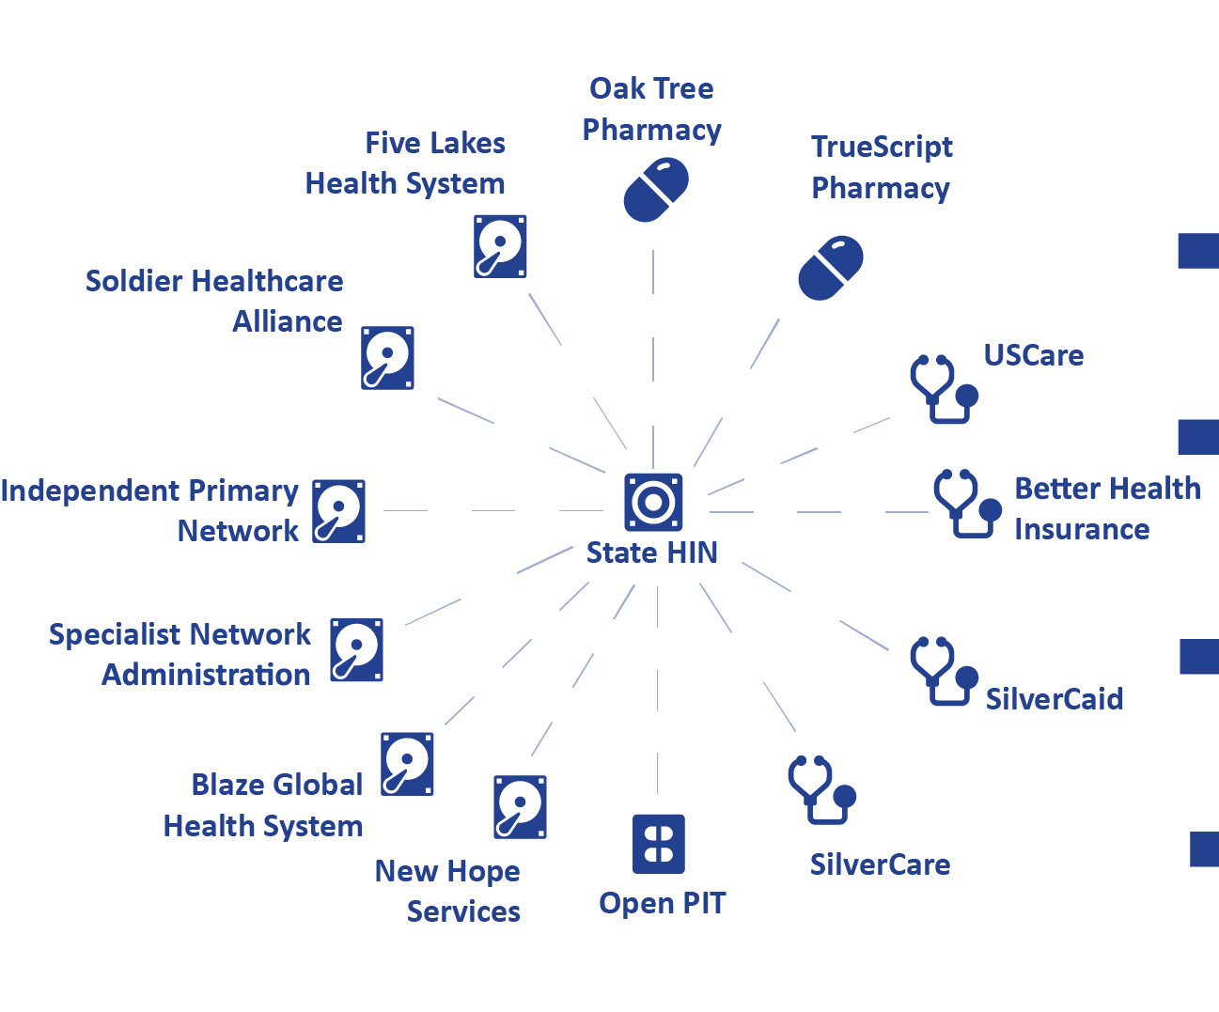
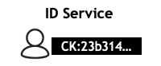
About our Data Platform
2
FHIR Healthcare
Ecosystem Sandbox
Notes:
Add animation.

Slide 20
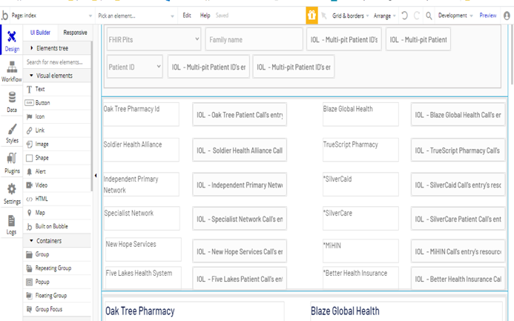
About Query Kit Development
3
Create Queries
Using REST APIs
4
Query Kit
Repository
github.com/cmtfqs/queries
GET https://PLATFORM/FHIR SERVER/fhir/ Patient?name=[name]
Patient?identifier=[CommonKey]
MedicationDispense?subject=[]&_count=[]&_sort+date
MedicationStatement?patient=[]&_count=[]&_sort+date
…
GET server/resource
Query Kit
db
"resourceType": "Patient", "id": "4", "meta": { "versionId": "1", "lastUpdated": "2020-05-03T23:32:53.000+00:00", "source": "#IiKi5LhKDRHzTAn7" }, ",{ "url": "identifier": [ { "use": "official", "type": { "coding": [ { "system": "http://hl7.org/fhir/identifier-type", "code": "SB", "display": "Social Beneficiary Identifier" } ] }, "system": "http://hl7.org/fhir/sid/us-ssn", "value": "000003023" }, { "use": "official", "type": { "coding": [ { "system": "http://hl7.org/fhir/identifier-type", "code": "SB", "display": "Social Beneficiary Identifier" } ] }, "system": "http://mihin.org/fhir/cks", "value": "0640331fb20e4db788a488868ea4b5c3" } ],
Working
App
Wireframes
5
FHIR Data
APP Wireframe

Slide 21
Generalizing Our Setup
1
2
3
4
5
Health Data Standards
Sandboxes with Synthetic Data
Query
Kit Repos
APP Development Platforms
API / Query Tools
App End User
App Developer
Notes:
Add animation.

Slide 22
Query Kit for Medication Reconciliation
1
Patient Last Name Query
returns
List of Patients With Same Last Name
Selects One Patient
2
returns
Patient Common Key Query
Selected Patient’s Common Key
3
Patient Data Inquiry Queries
return
Local Patient ID, when found
4
Medication Data Queries
return
Medication Request OR Medication Statement
Patient Application Gains All Available Medication Information for One Patient
Notes:
Animation.

Slide 23
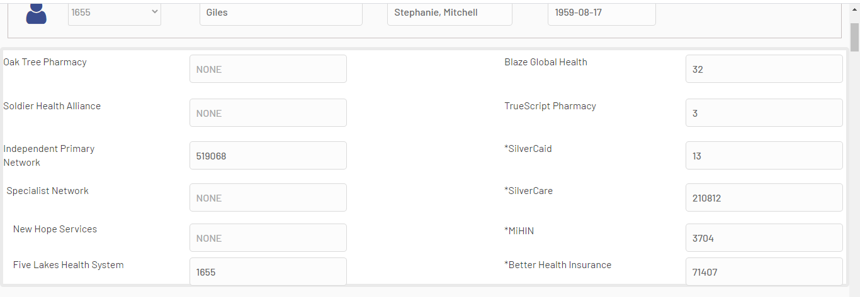
App Using Query Kit for Medication Reconciliation
Not a Real Person!
Independent Primary Care Network
Aspirin
Levothyroxine
Nabumetone
Blaze Global Health
Aspirin
Silvercaid
Levothyroxine
MIHIN
Aspirin
Levothyroxine Lisinopril
Nabumetone
True Script Pharmacy
Albuterol
Levothyroxine
Lisinopril
Nabumetone
Silvercare
Albuterol
Better Health Insurance
Levothyroxine Lisinopril
Nabumetone
Five Lakes Health System
Levothyroxine
Lisinopril
Nabumetone
View of Where One Patient’s Data Was Found
Notes:
Can we make these images easier to see.

Slide 24
Query Kit for Social Determinants of Health
1
Patient Last Name Query
returns
List of Patients With Same Last Name
Selects One Patient
2
returns
Patient Common Key Query
Selected Patient’s Common Key
3
Questionnaire Queries
returns
Available Questionnaires at Organizations of Interest
4
Patient Questionnaire
Response Queries
returns
Patient Responses to SDOH Questionnaire Items
Patient Application Gains All Available Questionnaire Responses for One Patient

Slide 25
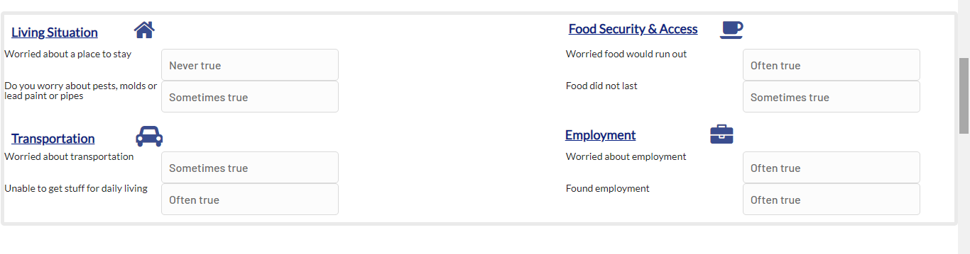
Query Kit for Social Determinants of Health
App View of Most Recent Patient Answers to SDOH Questionnaires

Slide 26
Available GitHub Repository with Query Kits
Go to https://github.com/cmtfqs/queries
Sharing Query Kits as POSTMAN collections for these use cases
Telemedicine
Medication reconciliation
Social determinants of health
Documentation in a README
Easily convert queries to code in many programming languages, e.g. JavaScript

Slide 27
Audience Question #2
Which data resources and queries most interest you and your teams?
• SDOH data? • Patient reported outcomes? • Continuity of care data? • Treatment outcomes data?

Slide 28
About our ongoing educational program

Slide 29
Education on FHIR & Interoperability – Initial Results
From: FALL 2020
INTRODUCTION TO HEALTH INFORMATICS,
University of Michigan

Slide 30
We Have a Growing Educational Program .
How to join in
Benefits
Contact today’s speakers or the Interoperability Institute for more information
interoperabilityinstitute.org/contact/
Instructional Materials
Interoperability
FHIR Standards
Querying HAPI FHIR servers
FHIR App Ecosystem Sandboxes
Public domain, open source https://interop.community/
Private, members only https://interoperabilityinstitute.org/interoperablityland/

Slide 31
Summary Points
Power of partnership
Our work anticipates coordinated FHIR Data Ecosystems with common patient IDs
Shareable standardized queries
Providing opportunities for the next-generation health IT workforce
Next Steps
Further curriculum development
Build and demo SMART-on-FHIR apps that use standardized Query Kits for FHIR
Provide feedback to improve app testing platforms

Slide 32
Any Questions About All This Stuff?
Query Kits (Shareable Complex Multi-target FHIR Queries)
Platforms & Tools (Interoperability Land, Postman, Github, Bubble.io)
Goal of Accelerating Health App Development
How Are Organizations Going to Expose Their Data APIs?
Goal of Educating the HIT Workforce of the Future
Expanding Partnerships to achieve Holistic Interoperability

Slide 33
Thank you!
Helen Hill → helen_hill@comcast.net
Allen Flynn → ajflynn@umich.edu
HIMSS Michigan Chapter
University
of Michigan

